Slide 1
SAP HANA on Azure
Speaker’s name here

Slide 2
Abstract and learning objectives
Abstract
In this workshop, you will look at what is involved in deploying SAP HANA on Azure with the goals of designing for high availability, disaster recovery as well as supportability.
At the end of this workshop, you will be able to better design and deploy SAP HANA on Azure.
Learning objectives
Design high availability for SAP HANA workloads on Azure VMs
Design disaster recovery for SAP HANA workloads on Azure VMs

Slide 3
Step 1: Review the customer case study
Outcome
Analyze your customer needs.
Timeframe
30 minutes

Slide 4
Customer situation
Contoso Group
Contoso Group is a global pharmaceutical company with its headquarters based in Boston, US.
Contoso has been using SAP ERP and BW on HANA for its Finance/Logistics/Analytics systems on the HP-UX/Oracle platform.
Contoso Leadership and Planning Groups wants to drastically reduce server and storage hardware in their own datacenters to minimize IT related costs. Contoso has already a number of their non-SAP systems migrated to Azure. The leadership asked Contoso IT to look into the possibility of migrating its SAP HANA environment to cloud.
Contoso IT decided to leverage its knowledge of the Microsoft cloud platform and existing ExpressRoute connectivity and host its SAP landscape in Azure. The intention is to migrate the BW system first (go live in March CY18), and migrate ECC in Q4 of CY18. The multi-stage approach is supposed to minimize potential migration risks.
Considering that Contoso management team often uses BW to support their management decisions, the systems should be highly available and their performance must be predictable and consistent. In addition, the management team wants to leverage disaster recovery capabilities offered by Azure in order to ensure resiliency of the migrated environment in case the primary region hosting the new deployment becomes unavailable.
Before migrating the production environment, Contoso wants to test its new deployment approach by provisioning training, development, test, and UAT environments in Azure.

Slide 5
Customer needs (1/3)
Scope : SAP BW on HANA deployment in Azure VMs
Go-live date : March 2019
Customer requests flexible VM solution within Cloud to accommodate the BW workloads.
Sizing
Production with latest OS/DB fully certified and supported by SAP
HANA sizing memory requirement 1.2 TB of RAM, estimate 1.9 TB of RAM in 3 years
Storage/volume configuration is based on Microsoft guidance
SAP BW application servers: 15K SAPS
Certification is NOT required for non-Prod
QA : HANA database server: 800 GB of RAM
Dev, Test : HANA database server(s): 256 GB of RAM

Slide 6
Customer needs (2/3)
Availability and Backup
HA solutions need to be proposed for Production, No HA for all Non-Prod
With HA option, data loss not allowed (zero RPO), no single point of failure, in case of server/storage issues, auto failover to complete within 10 minutes
Uptime – Prod: 24x7, 744 hrs/m, QA - 50 hrs/m, DEV/Test - 200 hrs/m
HANA DB log backup taken every 30 minutes
DB log backup to be kept for 1 day (DB restore to be fast)
HANA DB full backup every day (night)
Daily HANA DB full backup to be retained for 1 month
Monthly HANA DB full backup for 1 year, annual for 3 years
use reasonable backup storage in Cloud
Do BYOL of 3rd party backup solution (e.g. Commvault)

Slide 7
Customer needs (3/3)
End user access and system integrations
User locations – 300 from US, 50 LATAM, 50 Europe - all through corporate network and MPLS
Data is transferred from ERP (on-premises) to BW (in Cloud) every hour
Currently ExpressRoute is set up to Azure East US 2
User response time needs to be minimized
Management
Deploy Jumpbox, DNS, patching server, backup server, monitoring

Slide 8
Customer questions and objections
ERP/ECC remains on-premises until Dec CY19 – how can we maintain integrations between ECC and BW?
How much does Azure cost? Give us a few options.
Do I have to pay for virtual machines when they are stopped?
Can I automate the shutdown of virtual machines at periodic times of day?

Slide 9
SAP on Azure — huge variety on instances
NetWeaver Certified
NetWeaver and
HANA certified soon
NetWeaver and
HANA certified
NetWeaver Certified and HANA certified
SAP HANA certified
Ev3
M
A
Av2
Dv2
Dv3
G
General purpose
workloads
Compute intensive
workloads
Memory optimized for Dev/Test & PoC HANA workloads
Memory optimized for Dev/Test & PoC HANA workloads
Optimized for large production SAP HANA workloads
Purpose built instance for largest SAP HANA production workloads
HIGHEST VALUE
LARGEST SCALE-UP
Max vCPUs
16 |  | 16 | 64 | 64 | 32 | 128 | 960
112 |  | 56 | 256 | 432 | 448 | 3800 | 20000
382 |  | 1000 | 256 | 864 | 6144 | 4000 | 47000
Max RAM (GiB)
Max Local
Storage (GiB)

Slide 10
Determine Azure SKUs for HANA based on HANA DB Size and SAPS
 | HANA Scenario and DB/RAM size | Select a Compute SKU based of RAM size required for HANA Database server(s) | Combine Compute SKUs based on SAPS required for SAP application servers
1 | Dev and Test up to 4TiB (of RAM) | E16s v3, E32s v3, E64s v3, M32ls, M32ts, M64ls, M64s, M64ms, M128s, M128ms | D v3, E v3, Fractional M VMs – scale out
2 | Production - OLTP 192GiB to 4TiB (of RAM) | M32ls, M32ts, M64ls, M64s, M64ms, M128s, M128ms – scale up | D v3, E v3, Fractional M VMs – scale out
3 | Production – OLTP 4.1 to 24TiB (of RAM) | HANA Large Instances S192xm, S384m…. S960m, S768xm – scale up | D v3, E v3, Fractional M VMs – scale out
4 | Production – OLAP 1 to 2TiB (of RAM) | M64s, M128s – scale up | D v3, E v3, Fractional M VMs – scale out
5 | Production – OLAP 2.1 to 4TiB (of RAM) | HANA Large Instances S384 – scale up | D v3, E v3, Fractional M VMs – scale out
6 | Production – OLAP 4.1 to 60TiB (of RAM) | HANA Large Instances S72, S96, S192 and S384 – multiple nodes Scale out up to 16 nodes | D v3, E v3, Fractional M VMs – scale out
(*) OLAP : BW on HANA, BW/4HANA, Enterprise DWH, Sidecar | OLTP : S/4HANA, Business Suite on HANA, NetWeaver

Slide 11
M-Series Virtual Machines Massive memory, CPU, storage, and scale
Hyper-Threaded support
Premium Storage and Write Accelerator support
Based on Intel® Xeon® Processor E7-8890 v3
High Performance DDR4 memory
SAP Certified for both HANA and AnyDB
(*) OLAP : BW on HANA, BW/4HANA, Enterprise DWH, Sidecar
(*) OLTP : S/4HANA, Business Suite on HANA, NetWeaver
VM size | vCPU | Memory: GiB | SAPS | Max cached IOPS | Max cached storage throughput (GiB) | Network Bandwidth | HANA Workload
M32ts | 32 | 192 | 33,670 | 40,000 | 400 | 8 Gbps | OLTP
M32ls | 32 | 256 | 33,300 | 40,000 | 400 | 8 Gbps | OLTP
M64ls | 64 | 512 | 66,600 | 80,000 | 800 | 16 Gbps | OLTP
M64s | 64 | 1,024 | 67,315 | 80,000 | 800 | 16 Gbps | OLAP and OLTP
M64ms | 64 | 1,792 | 68,930 | 80,000 | 800 | 16 Gbps | OLTP
M128s | 128 | 2,048 | 134,630 | 160,000 | 1,600 | 25 Gbps | OLAP and OLTP
M128ms | 128 | 3,800 (= 4,080 GB) | 134,630 | 160,000 | 1,600 | 25 Gbps | OLTP
Notes:
Key talking points:
The M-series is the largest instance size with up to 128 virtual cpu’s (VCPUs). These instances support premium storage for low latency workloads and are designed for the largest enterprise workloads. These have huge RAM sizes from 1.75TB to 4.0TB of RAM!

Slide 12
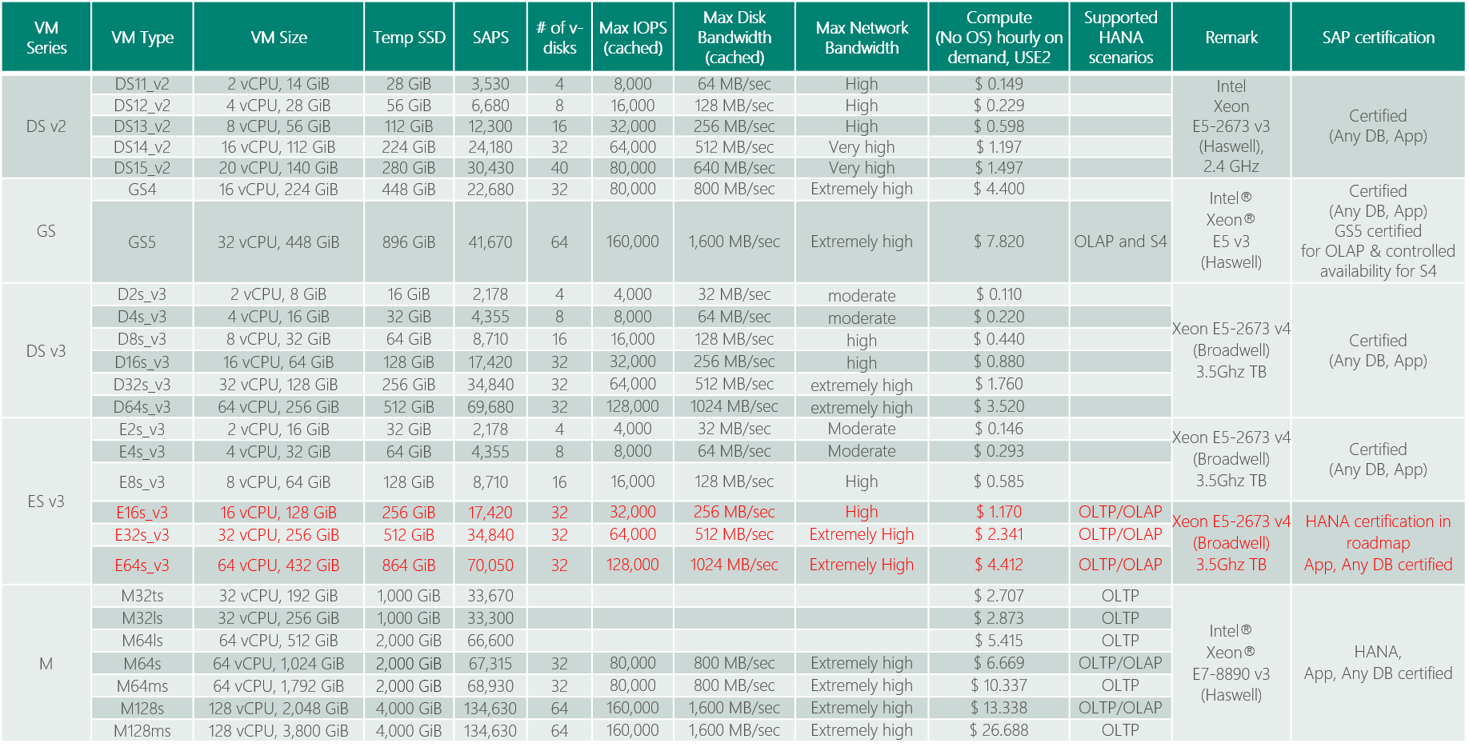
(SAPS) Azure VM Options for SAP Applications
SAP Note 1928533 and https://docs.microsoft.com/en-us/azure/virtual-machines/windows/sizes-memory
Red: certification in roadmap
Notes:
Double clicking Azure VMs /- here’s the list of SAPS and memory size / of each Azure VM type. D v2 and G are certified as of today / and E v3 and M Series release and certification / are coming soon / with official numbers of SAPS. Customer should feel very free to use / E v3 and M / for their non-prod even without certification / because it works just fine.
Based on total # of SAPS for Any DB, and memory size and HANA scenario – OLAP or OLTP, you can pick VM type for both database server and application server.
https://docs.microsoft.com/en-us/azure/virtual-machines/windows/sizes-memory
https://azure.microsoft.com/en-us/blog/introducing-the-new-dv3-and-ev3-vm-sizes/

Slide 13
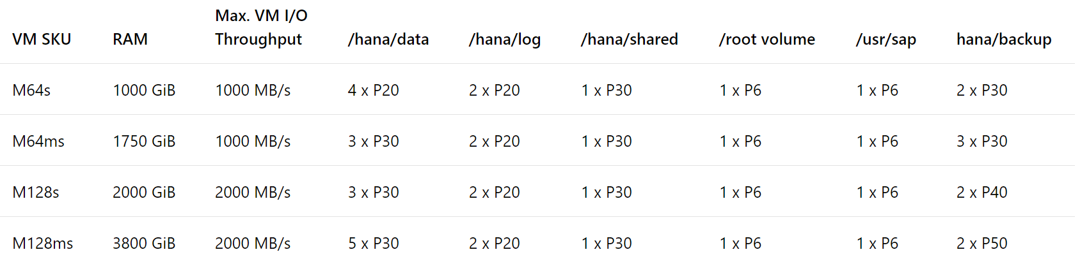
Premium Storage Allocation to run SAP HANA on Azure M Series VM
Enable Write Accelerator
All the disks building those volumes should have caching of those disks set to 'None'.
https://docs.microsoft.com/en-us/azure/virtual-machines/workloads/sap/hana-vm-operations
As stripe sizes for the RAID 0 the recommendation is to use:
64K or 128K for /hana/data
32K for /hana/log (as Only smaller I/O sizes (<=32KiB) are taking the accelerated path of Write Accelerator)
https://docs.microsoft.com/en-us/azure/virtual-machines/linux/how-to-enable-write-accelerator

Slide 14
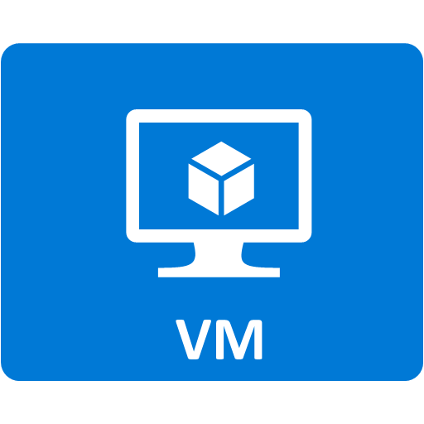
Premium Storage KPIs (Cost differ by region)
Premium Storage Disk Type | P4 | P6 | P10 | P15 | P20 | P30 | P40 | P50
Disk size | 32 GB | 64 GB | 128 GB | 256 GB | 512 GB | 1024 GB (1 TB) | 2048 GB (2 TB) | 4096 GB (4 TB)
IOPS per disk | 120 | 240 | 500 | 1100 | 2,300 | 5,000 | 7,500 | 7,500
Throughput per disk | 25 MB/s | 50 MB/s | 100 MB/s | 125 MB/s | 150 MB/s | 200 MB/s | 250 MB/s | 250 MB/s
Consistent low latency SSD with predictable throughput
For high-performance IO-intensive DB workloads
Single digit ms latencies
Supports up to 4 TB blob/disk size
Stripe up to 64 disks for a total of 256 TB
Disk performance is dependent on the disk size, with up to 7,500 IOPS per disk
Pay for what you provision
Check Azure VMs for maximum IOPS
* Stripe Premium Storage Disks to aggregate
IOPS, Throughput and Storage Capacity

Slide 15
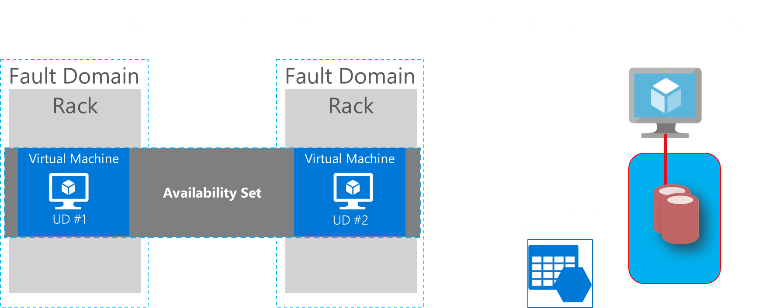
Common scenarios
Notes:
To produce the design, use the following sequence of steps.

Slide 16
SAP HA Architecture SAP NetWeaver ABAP / Java 7.00 (and higher) – Windows & Linux
(*) ASCS : ABAP SAP Central Services – part of SAP application servers running message/enqueue service, which is a single point of failure (SPOF)
SAP Instances in 4 Layers:
One or more Application Server Instances (Redundant Components)
One ASCS Instance (SPOF)
One File Share Instance (SPOF)
One Database Instance (SPOF)
AP
AP
…..
AP
(A)SCS
File Share
DBMS

Slide 17

Azure ILB
(A)SCS IP
Azure ILB
HANA IP
Azure AS
Azure AS
Azure AS
SAP ASCS
SAP <SID>
DBMS
AS
AS
(A)SCS
HANA
PRIMARY
SECONDARY
ERS
ERS
Availability Set
Availability Set
Linux Pacemaker Cluster
\\<SAPGLOBALHost>\sapmnt\<SID>\SYS\...
HANA System Replication
DRBD
Availability Set
Highly Available Linux DRBD (Software Replication)

Slide 18
Step 2: Design the solution
Outcome
Design a solution and prepare to present the solution to the target customer audience in a 15-minute chalk-talk format.
Timeframe
50 minutes
Business needs (10 minutes) | Respond to questions outlined in your guide and list the answers on a flipchart.
Design (35 minutes) | Design a solution for as many of the stated requirements as time allows. Show the solution on a flipchart.
Prepare (15 minutes) | Identify any customer needs that are not addressed with the proposed solution. Identify the benefits of your solution. Determine how you will respond to the customer’s objections. Prepare for a 15-minute presentation to the customer.

Slide 19










Partner Admin Network
Azure East US 2 Region
Web
Azure VNET (Hub)
Azure VNET (Spoke – SAP Prod/Non-Prod)
Customer Corporate Network
GW Subnet
Subnet DMZ
Subnet Shared Management
Subnet Prod BW AP+DB
Storage
Subnet Non- Prod BW AP+DB
Subscription
Running SAP HANA on Azure VM HA

Slide 20
Partner Admin Network
8
3
How to size storage to store backup ?
Where to deploy Jumpbox, Patching, DNS, Backup ?
Internet VPN?
5
Azure East US 2 Region
4
7
How to deploy highly available HANA DB and allocate storage for Production (1.2 -> 1.9TB) ?
How to allocate storage for data, log, shared, root and backup ?
Web
How to deploy VMs for SAP AP servers ? (15k SAPS)
Azure VNET (Hub)
Azure VNET (Spoke – SAP Prod/Non-Prod)
Customer Corporate Network
Internet VPN or private connect ?
GW Subnet
Subnet DMZ
Subnet Shared Management
Subnet Prod BW AP+DB
Storage
2
Subnet Non- Prod BW AP+DB
9
Subscription
How to deploy VMs for highly available SAP ASCS and NFS on Linux Clusters ?
How to deploy VMs and allocate storage for SAP AP Servers and HANA DB (800GB) for QA, Dev and Test (256GB each) ?
Running SAP HANA on Azure VM HA
Make sure to use VNET Hub-spoke topology
6
1

Slide 21
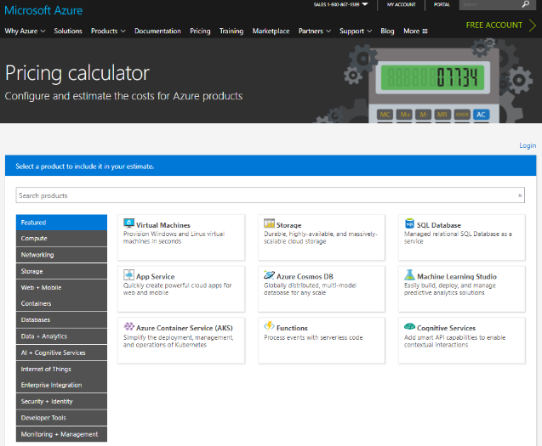
Online Azure pricing calculator
https://azure.microsoft.com/en-us/pricing/calculator/
Notes:
To estimate the cost of your solution, use Azure Pricing Calculator.

Slide 22
Pricing
** Customer is very cost sensitive
No need to include OS/DB license costs (Customer will do BYOL separately)
Do BYOL of 3rd party backup solution (e.g. Commvault)
ExpressRoute : Start with 500Mbps
ExpressRoute Additional outbound data transfer : 5TB/month
Make sure to include MSFT support (= Professional Direct)

Slide 23
Step 3: Present the solution
Outcome
Present a solution to the target customer in a 15-minute chalk-talk format.
Timeframe
20 minutes (10 minutes for each team to present and receive feedback)
Directions
Pair with another table
One table is the Microsoft team and the other table is the customer
The Microsoft team presents their proposed solution to the customer
The customer asks one of the objections from the list of objections in the case study
The Microsoft team responds to the objection
The customer team gives feedback to the Microsoft team

Slide 24
Wrap-up
Outcome
Identify the preferred solution for the case study
Identify solutions designed by other teams
Timeframe
20 minutes

Slide 25




Go Dos and Resources
Learn
SAP on Azure Website
SAP on MS Platform blog
SAP on Azure – SAP Community Wiki
SAP HANA/NetWeaver on Azure Documentation
HANA on Azure Large Instances Architecture
SAP on Azure reference architecture
Microsoft Partner Network – SAP on Azure
Whiteboard Design Session and Hands-on Lab (HANA and Any DB)
How Microsoft IT runs SAP
SAP on Azure case study videos
SAP HANA Academy
Open SAP
SAP on Azure Infopedia Product Hub (Internal)
SAP on Azure roadmap (Internal/NDA)
Battlecards (Internal)
SAP on Azure Tech Community Call (Internal)
Touch
SAP Cloud Appliance Library
SAP HANA on Azure SUSE Linux templates
SAP HANA on Azure ARM templates
Ask
SAP on Azure Yammer (Internal)
Contact SAP Technical Community saptalk@microsoft.com
Engage
Contact : Americas SAP on Azure CoE SAPGBBAMERICAS@microsoft.com, EMEA SAP on Azure CoE SAPGBBEMEA@microsoft.com or Asia SAP on Azure CoE SAPGBBASIA@microsoft.com

Slide 26
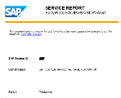
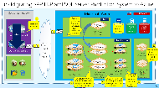
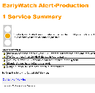

SAP on Azure - Cloud Assessment Session (= Architecture Design Session)
SAP on Microsoft Cloud
Cloud Assessment Session with Microsoft Global Black Belt Team
Inputs from customer
SAP Early Watch Report or HANA Sizing Report
or
Current hardware specifications (Server, storage, network)
Current software utilization (e.g. OS, DB, SAP, Non-SAP)
DB Metrics (e.g. DB volume)
Availability/security needs (Uptime, RPO/RTO, DR, Network)
Backup/Archival needs
Session Delivery (= 1 to 2 day)
Current SAP system analysis
Modernization scope & assumptions
Grand system design (e.g. Sizing, HA/DR/security, Performance, Automation)
Migration methodologies
Quote for Microsoft stack
Q&A
Deliverables
Written “To-Be” SAP architecture (Production, Non-Production)
ROI analysis
Planning of phased migration to minimize downtime and switching risks
Customer to share information on their current SAP/LOB systems
with Microsoft PEAT
Microsoft and Customer to discover how Microsoft Cloud and Technologies can best help modernize customer’s SAP/LOB systems
Customer to start to engage with their SI partner(s) to execute cloud modernization

Slide 27
Latest SAP HANA on Azure content can be found at : https://github.com/Microsoft/MCW-SAP-HANA-on-Azure

Slide 28
Check SAP on Azure Certifications (HANA)
Category | Scenario | SAP Product | Guest OS | Database | VM/Server Type
SAP HANA | OLAP | SAP Business Warehouse (BW); BW/4HANA, HANA Enterprise, HANA Side Car | SUSE, Red Hat | SAP HANA | GS5, E_v3, M (with Premium Storage + Write Accelerator), HANA on Azure (Large Instances)
 | OLTP | S/4HANA | SUSE, Red Hat | SAP HANA | GS5 (** Controlled Availability), E_v3, M (with Premium Storage + Write Accelerator), HANA on Azure (Large Instances)
 | OLTP | SAP Business Suite on HANA, SAP NetWeaver | SUSE, Red Hat | SAP HANA | E_v3, M (with Premium Storage + Write Accelerator), HANA on Azure (Large Instances)
 | OLTP | SAP Business One on HANA | SUSE, Red Hat | SAP HANA | DS14_v2, E_v3, M (with Premium Storage + Write Accelerator)
 | - | SAP HANA One | SUSE, Red Hat | SAP HANA | DS14_v2
Red text: SAP certification is in future roadmap
Notes:
This is the breakdown of Any DB and HANA / - list of SAP products / that are certified to run in Azure.
All SAP products with Any DB / are fully certified – such as SAP Business Suite, NetWeaver, Business Objects and Business one. The supported platforms are / Windows and Linux, / and SQL, ASE, Oracle, MaxDB and DB2/UDB. The VMs that you can use are / D v2 and G Series VM as of today / and D v3, E v3 and M Series VM / will be available later this CY.
All SAP products with HANA / are also certified – OLAP solutions like Business Warehouse, HANA Enterprise, Side Car / are certified with GS5 VM and HANA Large Instances. OLTP solutions like S/4HANA, Business Suite on HANA are good with Large Instances today, and with D v3, E v3 and M Series VM by the end of this CY.
Certification for Oracle Linux OS and SAP Business One on HANA is coming soon.

Slide 29
Enterprise Backup Solutions for LOB applications/SAP on Azure
Fully online backup of SQL Server databases, Files and OS states while system overhead is minimum
Backup to Azure Blob Storage (= Azure Backup Vault)
Point-in-time restore
Saving backup storage (= Incremental Backup)
Centralized console for monitoring and alert capabilities
1
2
3
4
5

Slide 30
SAP on Azure Backup Solutions
 | Standard DB backup (e.g. SQL, Oracle, HANA) |  | Azure Backup Server (=SCDPM on Azure) | 3rd party solutions (e.g. Commvault, NetBackup) | Azure IaaS VM Backup | HANA on Azure Large Instances Storage Snapshot
Backup type | Database |  | Network/Agent | Network/Agent | Snapshot | Storage level snapshot
Backup target | DBs within Azure VMs |  | SQL Server DBs, Files and OS States (Windows) within Azure VMs (link) | SQL Server/Oracle/HANA, Files and OS States (Windows, Linux) within Azure VMs | Azure VMs (Windows, Linux) running SQL Server (link) | HANA database volume, HANA log volume, boot volume (link)
Linux (Guest OS) support | - |  | No | Yes | Yes | Yes
SQL Server database backup capability | Transaction log (every minute), differential, full |  | Differential every 15 minutes and full (express) | Yes | Up to 3 times per day | -
Oracle database backup | No |  | No | Yes | File consistent backup with RMAN | -
Compression | Supported |  | Supported (storage sizing : link) | Supported | None | -
Backup servers running on | DB Server |  | Microsoft Azure Backup Server (on VM) (installation kits downloadable from Azure Portal) (VM sizing : link) | Backup Server (on VM) | None (Backup as a Service) | -
Agent software required | No |  | Agent in backup target VMs and Azure Backup Agent in Azure Backup Server VMs | Yes | No (* Only Azure VM Agent) | No
Network bandwidth required | Yes but controllable |  |  |  | None | None
Short term retention | Yes (on local storage) |  |  |  | None | Yes (on local NFS storage)
Long term retention | Possible |  |  |  |  | Up to 255 snapshots per volume (or transfer to Blob Storage)
Point-in-time recovery | Possible
Recovery speed | Depend on I/O speed of underneath Blob storage or Backup Vault |  |  |  |  | Fast
Monitoring/alerting console | Database console | Azure Backup Server Console |  | Backup Server Console | Azure Management Portal | Script
Reporting | Database console | System Center Service Manager |  | Backup Server Reporting | None | Script
Licensing | Built-in | Pay-per-use on Azure (link) |  | Check vendor | Pay-per-use on Azure (link) | Built-in

Slide 31
Disaster Recovery Solutions for LOB applications/SAP on Azure
Business requirements
Minimum data loss in case of a disaster
Failover complete within hours including SAP application layer
Clear failover process
Failover transparent to users and sub systems
Minimum costs for DR
IT requirements
Production environment is on virtualization, bare metal or cloud
Minimum overhead on Production systems and network
Retire traditional SAN/Tape-based solutions
1
2
Database Replication (e.g. SQL Server AlwaysOn)
File Replication (e.g. File Copy)
VM Replication (Azure Site Recovery)
(*) Note : ASR doesn’t support replication from shared cluster disk or Win 2016 SOFS
Notes:
https://docs.microsoft.com/en-us/azure/site-recovery/site-recovery-support-matrix-to-azure

Slide 32
Downtime Minimized Migration (DMO/SUM) to Azure/HANA
DMO with System Move
– change PAS host during DMO
Source SAP: DMO/SUM 1.0 SP21 Guide (source PAS must be UNIX/LINUX based)
Notes:
Downtime minimized migration to HANA via DMO/SUM – system move. Source primary application server (PAS) must be UNIX/LINUX based.

